Slide 1
Container Technologies in Azure Dan Gartner Cloud Solutions Architect, Microsoft
Notes:
Optional:

Slide 2
Microsoft Container Technologies
Introduction to Containers
What are containers and why customers are turning to containers
Container adoption trends
Microsoft Container Technologies
Positioning Container Offerings
References and call to action

Slide 3
Introduction to Containers
Notes:
Optional:

Slide 4
Container overview
Dependencies: Every application has its own dependencies which include both software (services, libraries) and hardware (CPU, memory, storage).
Virtualization: Container engine is a lightweight virtualization mechanism which isolates these dependencies per each application by packaging them into virtual containers.
Shared host OS: Processes in containers are isolated from other containers in user space, but share the kernel with the host and other containers.
Flexible: Differences in underlying OS and infrastructure are abstracted away, streamlining ‘deploy anywhere’ approach.
Fast: Containers can be created almost instantly, enabling rapid scale-up and scale-down in response to changes in demand.
Container
App A Bins/Libraries
App B Bins/Libraries
Host OS w/Container Support
Server
Notes:
Now that we understand a little more about why containers are important to both operations, and developers, it’s important to understand just what is a container.
As you can see from the graphic on the right hand side, at the base we have a server. This could be physical, or virtual, and at this stage, it doesn’t matter. On that server, is a host operating system, which, for the purpose of a containers discussion, has container support within the kernel.
If you think about an application, each app tends to have it’s own dependencies. This could include software, such as services, or libraries, or it could have hardware dependencies, such as CPU, memory, or storage. The container engine that exists within the host OS is essentially a lightweight virtualization mechanism which isolates these dependencies on an application by application basis, by packaging them into virtual containers.
The differences in underlying OS and infrastructure are abstracted away – as long as the base image is consistent, the container can be deployed and run anywhere, which for developers, is incredible attractive.
These containers run as isolated processes in user space, on the host operating system, sharing the kernel with other containers. These containers can be created also instantly, which unlocks rapid scale-up and scale-down scenarios in response to changes in demand from the business.

Slide 5
Containers How do they differ from virtual machines?
Dependencies: Each virtualized app includes the app itself, required binaries and libraries and a guest OS, which may consist of multiple GB of data.
Independent OS: Each VM can have a different OS from other VMs, along with a different OS to the host itself.
Flexible: VMs can be migrated to other hosts to balance resource usage and for host maintenance, without downtime.
Secure: High levels of resource and security isolation for key virtualized workloads.
Virtual Machine
App A Bins/Libraries
App B Bins/Libraries
Guest OS
Guest OS
Hypervisor
Server
Notes:
But how do these containers differ from VMs?
Well, if you think about a VM, each VM typically includes the app itself, required binaries and libraries and a guest OS, which may consist of multiple GB of data. This runs on top of a hypervisor, and consumes a slice of resources from the underlying host operating system. One advantage of the virtualization approach, is that the virtual machines can contain different guest operating systems to one another, and to the host operating system, which provides considerable flexibility and high utilization. In addition, virtual machines can be flexibly migrated from host to host, preserving state, and granting administrators with considerable flexibility, especially in scenarios such as resource optimization and maintenance. Virtual machines also offer very high levels of isolation, both resource and security, for key virtualized workloads.

Slide 6
Containers inside virtual machines Deployment options suited to many scenarios
Containers in VMs: By combining containers with VMs, users can deploy multiple, different VM operating systems, and inside, deploy multiple containers within those guest OSs.
By combining containers with VMs, fewer VMs would be required to support a larger number of apps.
Fewer VMs would result in a reduction in storage consumption.
Each VM would support multiple isolated apps, increasing overall density.
Flexible: Running containers inside VMs enables features such as live migration for optimal resource utilization and host maintenance.
Virtual Machine
Container
App A Bins/Libraries
App A Bins/ Libraries
App B Bins/ Libraries
Guest OS
Guest OS w/ Container Support
Hypervisor
Server
Notes:
You can however, achieve a ‘best-of-both worlds’ approach.
Containers run on a host OS, but that host OS doesn’t need to be a physical host. By combining containers with VMs, users can deploy multiple, different VM operating systems, and inside, deploy multiple containers within those guest OSs.
By combining containers with VMs, fewer VMs would be required to support a larger number of apps and fewer VMs would result in a reduction in storage consumption.
Each VM would support multiple isolated apps, albeit sharing the same guest operating system for the base image, but increasing overall density. This provides IT with considerable flexibility, as running containers inside VMs enables features such as live migration for optimal resource utilization and host maintenance.

Slide 7
What is a container?
Containers
Windows Server containers Maximum speed and density
= Operating system virtualization
OS
Container
Container
Container
Applications
Container
Container
Container
Kernel
OS
Hardware
Kernel
Traditional virtual machines = hardware virtualization
Hyper-V containers Isolation plus performance
Application
VM
VM
VM
Container
Container
Container
OS
Hardware
Kernel
Kernel
Kernel
Hyper-V
Notes:
When it comes to applications, historically, IT administrators deployed with a 1:1 application to server ratio. When a new application was required by the business, it was deployed onto a newly provisioned physical system, to ensure no conflicts with existing applications and workloads. This resulted in a huge number of physical servers, all with very low utilization.
Fast forward to a more modern datacenter, where virtualization is now prevalent, and you’ll find significantly higher consolidation ratios, much greater utilization and significantly accelerated app deployment speeds as administrators deploy applications in minutes, compared with hours, days or weeks in a purely physical datacenter.
Compared with applications that ran on individual physical servers, the compatibility of those same apps to run inside virtual machines was typically very high. After all, the virtual machine just presents virtual hardware to the same operating system that was running in the physical world. The only consideration being, if that application or workload has a requirement for a specific piece of hardware, such as a PCI-E card, that couldn’t be virtualized and presented through to the guest operating system. In addition, once that application was encapsulated inside the virtual machine, it benefited from higher levels of redundancy, and also mobility, through features such as live migration.
There is however, a new and increasingly popular way to build, ship, deploy and instantiate applications. Containers can further accelerate application deployment and streamline the way IT operations and development teams collaborate to deliver applications to the business.
But what are containers? Well, to give the computer science definition, containers are an operating system-level isolation method for running multiple applications on a single control host. With developers building, and then packaging their applications into containers, and providing them to IT to run on a standardized platform, it reduces the overall effort to deploy applications, and can streamline the whole dev and test cycle, ultimately reducing costs. As containers can run on a host OS which itself could be physical or virtual, it provides IT with flexibility, and the opportunity to drive an increased level of server consolidation, all whilst maintaining a level of isolation that allows many containers to share the same host operating system.
Windows Server containers are isolated behind their own network compartment. This can be provided a NAT DHCP or Static IP. Each container has an independent session namespace, which helps to provide isolation and security. The kernel object namespace is isolated per container.
Hyper-V Containers take a slightly different approach to containerization. To create more isolation, Hyper-V Containers each have their own copy of the Windows kernel and have memory assigned directly to them, a key requirement of strong isolation

Slide 8
Containers offer unique capabilities
Fast iteration
Defined state separation
Resource controls
Immutability
Rapid deployment
Notes:
Containers are attractive for developers and for IT for a number of reasons:
Fast iteration: Containers allow for rapid iteration through the development process both because they are lightweight and because of the way the application is packaged with its dependencies
Defined state separation: Changes to the container don’t affect other containers.
Resource controls: The host controls how much of the host’s resources can be used by a container. Governing resources like CPU, RAM and network bandwidth ensure that a container gets the resources it expects and that it doesn’t impact the performance of other containers running on the host.
Immutability: Changes made within one container won’t affect containers running on the same host.
Rapid deployment: Since containers are lightweight in terms of resources, they are easy to move, copy, and share. This enables rapid application deployment.

Slide 9
Container benefits A new approach to build, ship, deploy, and instantiate applications
Applications traditionally built and deployed onto physical systems with 1:1 relationship.
New applications often require new physical systems for isolation of resources.
Package and run apps within containers.
Physical/ Virtual
Physical
Higher consolidation ratios and better utilization.
Faster app deployment than in a traditional, physical environment.
Apps are deployed into VMs with high compatibility success.
Apps benefit from key VM features, such as live migration, HA.
Key benefits
Further accelerate app deployment.
Reduce effort to deploy apps.
Streamline development and testing.
Lower costs associated with app deployment.
Increase server consolidation.
Virtual
Notes:
But why do we need containers? What do containers provide that virtual machines can’t? Who is driving the momentum behind containers?
Applications are fueling the innovation in today’s cloud-mobile world, and developers hold the keys to the power of those applications. The more streamlined and efficient the process for developers to build and deliver their applications, the faster that more powerful applications can reach the business. This however, has to work across both the developers, and IT who hold the keys when it comes to the infrastructure that the applications will run on.
For the developers, containers unlock huge gains in productivity, and freedom – the ability to build an application, package within a container, and deploy, knowing that wherever you deploy that container, it will run without modification, whether that is on-premises, in a service provider’s datacenter, or in the public cloud, using services such as Microsoft Azure. These containers don’t have to be deployed independently – developers can model complex multi-tier applications, with each tier packaged within a container, and these can be distributed across IaaS and PaaS models, again, increasing the overall surface area that the developer can aim for when releasing their application. This powerful abstraction of microservices architectures provides developers with incredible potential to deliver applications more rapidly than ever before. They can’t however, do it without the Operations’ team support.
On the Operations side, they benefit considerably by being able to gain ever higher levels of consolidation for applications and workloads than even virtualization could provide, and in addition, they can put in place a platform that can rapidly scale up and down to meet the changing needs of the business. This standardized platform is easier to manage, yet provides the developers with a consistent environment into which they can simple provide their app, and hit ‘run’.
This integration across development and operations is what’s becoming known in the industry as DevOps. DevOps aims to integrate people, process and tools to streamline the application development and deployment process. Ops can focus on providing a standardized infrastructure and a set of resources that can be consumed by the development teams, and developers can focus on designing, building, packaging and testing their applications, using the platform that IT provide.

Slide 10
Container Technologies in Azure
Notes:
Optional:

Slide 11
Container Environments in Azure
Container Optimized VMs - IaaS
Azure Container Instances - Serverless
Azure Container Service – Multi-container Orchestrator
Service Fabric – Multi - Container Orchestrator
Azure App Service – Single Container PaaS
Azure Batch – Batch/HPC Compute

Slide 12
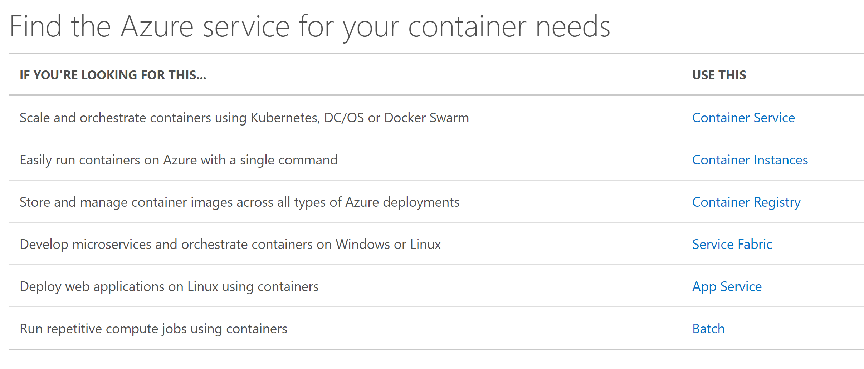
Containers in Azure

Slide 13
Azure Container Instances
Notes:
Optional:

Slide 14
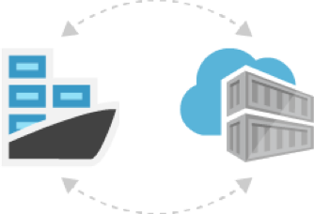
Azure Container Instances (Preview)
Get started in seconds with containers and control your infrastructure costs by taking advantage of per-second billing
No Virtual Machine (VM) management
Skip the need to learn new container orchestration tools—it's just your application, in a container, running in the cloud
Enterprise grade security with hypervisor isolation
Pay per use - container instances are billed on a per-second, per-vCPU, per-GB of memory
Easily deploy images from Docker Hub or Azure Container Registry

Slide 15
Azure Container Service
Notes:
Optional:

Slide 16
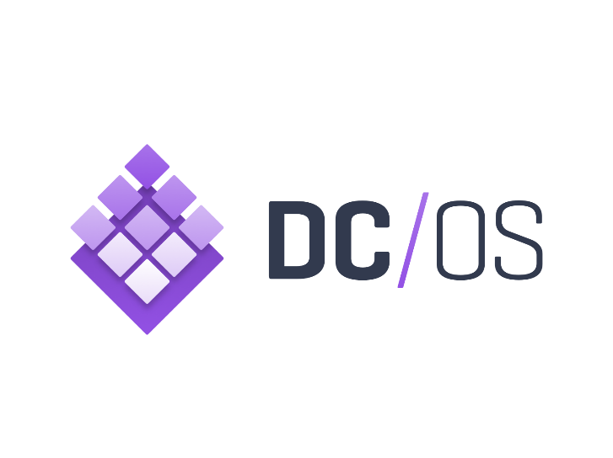

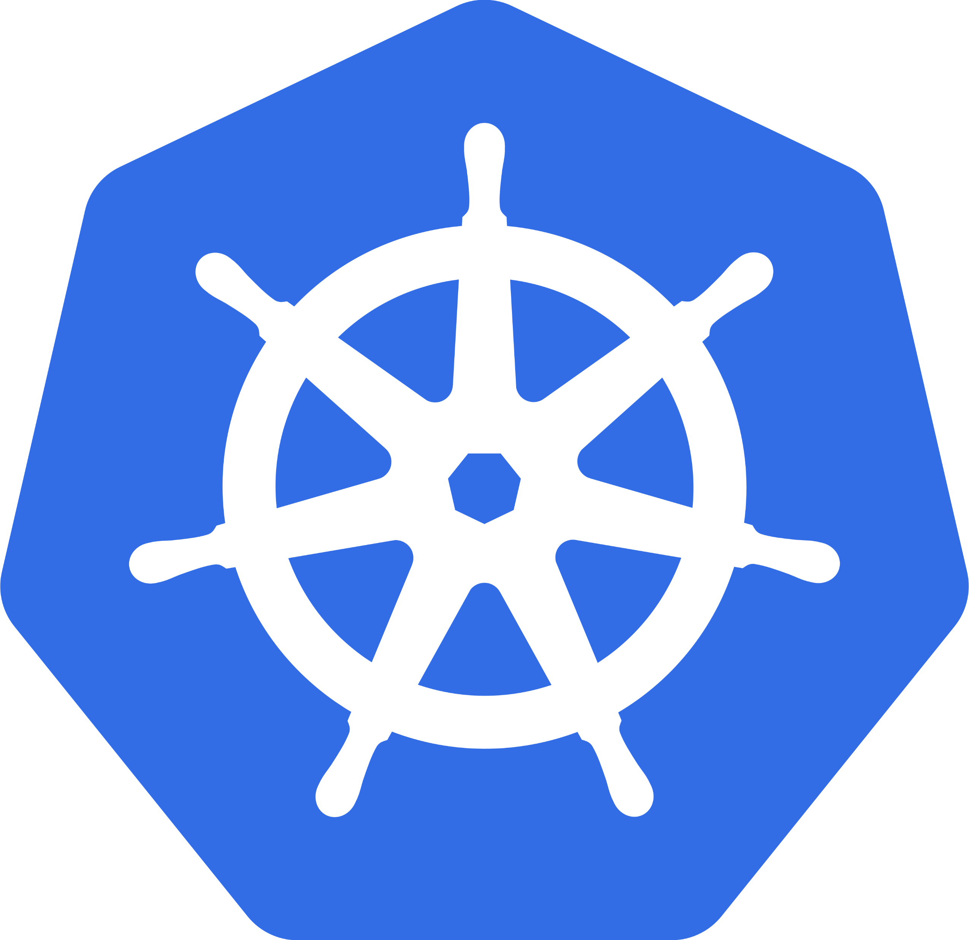
Azure Container Service
Choice of most popular container orchestrators
Simplest way to deploy open source container management platforms on Azure
Few clicks to enterprise grade container solution
<`/>
Command Line Interface
ARM templates
Container Registry
Container
Monitoring
DC/OS
Swarm
Windows &
Linux Containers
*Managed disks for
persistent storage
Kubernetes
Azure Portal
Notes:
Choice of most popular container orchestrators: Azure Container Service makes it simpler for you to create, configure, and manage a cluster of virtual machines that are preconfigured to run containerized applications. It uses an optimized configuration of popular open-source scheduling and orchestration tools. This enables you to use your existing skills, or draw upon a large and growing body of community expertise, to deploy and manage container-based applications on Microsoft Azure. Choose the tools and solution that best suits your needs for Docker container orchestration and scale operations. Use the Mesos-based DC/OS, Kubernetes, or use Docker Swarm and Compose for a pure Docker experience.
Simplest way to deploy containers on Azure: Azure Container Service provides rapid deployment of popular open-source container clustering and orchestration solutions. By using Azure Container Service, you can deploy DC/OS, Kubernetes, and Docker Swarm clusters with Azure Resource Manager templates or the Azure portal.
Few clicks to enterprise grade container solution: Azure Container Service optimizes the configuration of popular open source tools and technologies specifically for Azure. Work with the open source tools you know. Because we expose the standard API endpoints for our orchestration engine, you know the most popular tools will be compatible with Azure Container Service and, in most cases, will work out of the box—including visualizers, monitoring, continuous integration, command line tools, and even future tools as they become available.

Slide 17
Azure Container Service: the cloud’s most open option for containers
Azure Container Service
Azure
Simplest way to deploy your container orchestration environment on Azure
Agile, flexible, and provides choice of orchestrator
Open source templates for provisioning your environment
Easy ramp up to an optimized enterprise grade container management
DC/OS
Swarm
Kubernetes
Notes:
ACS is the simplest ways to deploy your container orchestration environment so your developers can deploy their apps more quickly
With ACS, in just a couple of clicks and a few keystrokes and you have a optimized enterprise grade container management solution
Azure container service is the only solution in the market today that is flexible and provides users the choice of container orchestration platforms such as Mesosphere DC/OS and Docker Swarm
We will remain open source, unlike any other vendor, we are completely committed to embracing the most popular solutions customers are using to orchestrate.

Slide 18
How do you deploy Azure Container Service?
Portal
Set up ACS cluster with few clicks
ARM template
Use well known ARM templates available in Github
Command Line Interface
Use Azure CLI to deploy ACS cluster
Templates available for DC/OS, Docker Swarm and Kubernetes
Save the generated ARM templates for future deployments
Configuration commands available to create and manage ACS clusters

Slide 19
Azure App Service
Notes:
Optional:

Slide 20
Azure App Service
Lightweight Container PaaS
The easiest and fastest way to run single container web apps
Bringing years worth of Azure PaaS innovations to Container Ecosystem
The platform will manage scaling, request routing and availability.
Easy way to setup SSL, custom domains, deployment slots, CI/CD.
Manage through portal, ARM templates or Azure CLI 2.0.

Slide 21
App Service – lightweight container PaaS
Enterprise-grade apps
Fully managed platform
High productivity development
Global data center footprint
Hybrid support
Built-in auto scale and load balancing
High availability with auto-patching
.NET, Java, PHP, Node, and Python
Staging and deployment
AAD integrated
Secure + compliant
Reduced operations costs
Backup and recovery
Testing in production
App gallery marketplace
Notes:
- Enterprise grade apps
1. Hybrid support - Our hybrid support allows enterprises to connect back to their on-premises systems.We see a lot of scenarios where they push their web app into App Service but leave their back-end systems on-premises and connect the two.
2. Secure + Compliant- with App Service Environment, you can have a dedicated isolated environment rather than a shared multi-tenant instance of App Service.This often allows our customer base with high security policies a way to leverage this platform as a service offering.
- Fully managed plaltform
1. NoOps – we handle the underlying operating system and manage all the updates, security patching etc. You just worry about the code you run in App Service.
2.Built in auto-scale – along with not having to manage patching, we also have built in auto-scale and load balancing. We'll handle everything under the covers to handle your spikes in traffic upscaling and downscaling your app.
- High productivity development
1. Staging and deployment – we have streamlined the ability of publishing versions of your applications via deployment slots. You can very quickly switch your approved staging version to production and App Service will handle all the infrastructure actions such as DNS Host changes and so on.
2.App gallery and marketplace – along with easy deployment from Visual Studio, you can also get started quickly with various applications in the gallery marketplace.

Slide 22
App Service Linux Worker Architecture Support for Docker containers

Slide 23


“We’re leveraging Azure App Service, we don’t want to maintain the underlying infrastructure, the OS, the patching and all that entails – instead we want to focus on delivering business value, quickly. ”
Mike Lorengo – Director IT Strategy Alaska Airlines
Challenge
Make an internal web app to book standby travel available to mobile employees wherever they are – in record time.
Benefits
Modern app experience for employees
Seamless web and mobile integration
Target multiple mobile platforms natively
Leverage existing on-premises API’s and services
Rapid development time with continuous integration and deployment
Notes:
Objective:
Show a real life example of a customer who has improved employee engagement and effectiveness by modernizing apps with Azure
Key talking points:
Alaska Airlines needed to make an internal web app to book standby travel available to mobile employees outside of the corporate firewall. Developers took the existing logic and moved the application to Azure App Service, created a mobile front end with Xamarin, and made the app available to employees in record time.
Five apps completed very quickly.
Leverages existing web application and on-premises services – they didn’t need to start from scratch.

Slide 24
Service Fabric
Notes:
Optional:
Service Fabric—Microservice Based Apps
Azure Service Fabric is a platform that developers and ISVs can use to build and manage custom microservice-based applications at cloud scale and with 24x7 availability. Microservices are an architectural approach based on fine-grained, loosely coupled services that can enable advanced developer agility, cloud scale, self-healing resilience and always on availability. Service Fabric is the foundation for many Microsoft services such as Azure SQL Database, Azure Document DB, Cortana, Windows Intune, and Skype for Business. We’ve taken the exact same technology and made it available to you. And use Service Fabric wherever you want to run your microservice based apps—whether in Azure, in your own datacenter or in other clouds—giving you maximum flexibility.

Slide 25
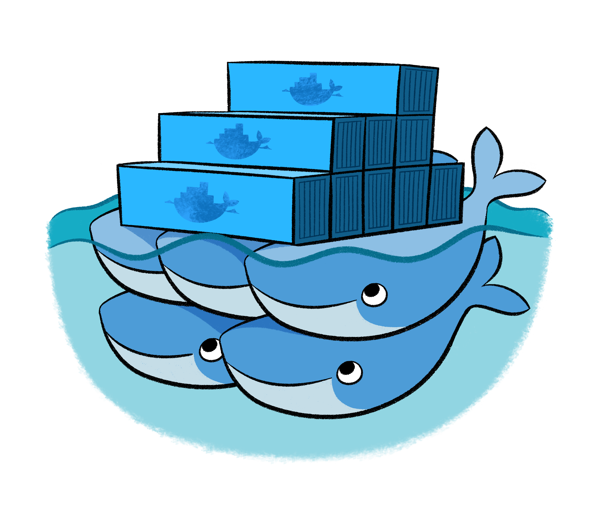
Azure Service Fabric
Hyperscale Microservices platform
Managed platform
High productivity development
Built-in auto scale and load balancing
High availability with auto-patching
Simple
Programming models for
.NET, Java
Stateful
Microservices
Highly scalable
24 X 7 availability
Health & monitoring
Available on
Private Cloud,
Public Cloud & Hosted Cloud
Learn easily using
Party clusters
Simple tooling with Visual Studio, Eclipse & Yeoman
Windows and Linux
container
orchestration
DevOps and
Lifecycle management
Notes:
Hyperscale Microservices platform: Azure Service Fabric is a distributed systems platform that makes it easy to package, deploy, and manage scalable and reliable microservices.
Highly scalable: Orchestration and automation for building microservices In Fabric gives new levels of app awareness and insight to automate live-upgrades with rollback and automatic scale-up and scale-down capabilities.
24*7 availability: Azure Service Fabric was born from years of experience at Microsoft delivering mission-critical cloud services including Skype for Business, Cortana. This experience allowed us to design a platform that can deliver highly available and durable services at hyperscale.
Windows and Linux container orchestration: Service Fabric supports the following types of containers. Docker containers on Linux, Windows Server containers and Windows Hyper-V containers
DevOps and Lifecycle Management: Service Fabric provides first-class support for the full application lifecycle of cloud applications, from development through deployment, daily management, and maintenance to eventual decommissioning.
Managed Platform: Service Fabric provides first-class support for the full application lifecycle of cloud applications, from development through deployment, daily management, and maintenance to eventual decommissioning.
Built-in auto scaling and load balancing: Service Fabric Delivers low-latency performance and efficiency at massive scale, by providing automatic scale up and down capabilities.
High availability and load balancing: Service Faabric is a platform that intrinsically understands the available infrastructure resources and needs of applications, enabling an automatically updating, self-healing behavior that is essential to delivering highly available and durable services at hyperscale.
Health and Monitoring: Azure Service Fabric introduces a health model that provides rich, flexible, and extensible health evaluation and reporting. You can easily obtain health information and correct potential issues before they cascade and cause massive outages.
Available everywhere: You can run Fabric in Azure, on-premises, or in other clouds
High productivity development:
Simple programming models: Service Fabric lets developers focus on building features that add business value to their application, without the overhead of designing and writing additional code to deal with issues of reliability, scalability, or latency in the underlying infrastructure.
Stateful microservices: Service Fabric supports stateful microservices (such as user accounts, databases, devices, shopping carts, and queues) maintain a mutable, authoritative state beyond the request and its response.
Simple Tooling: Service Fabric includes Includes Visual Studio tooling, as well as command line support, so developers can quickly and easily build, test, debug, deploy, and update their Service Fabric applications on single-box, test, and production deployments.
Party Clusters: You can use Service Fabric Party clusters that are open, public Service Fabric clusters hosted on Azure and run by the Service Fabric team where anyone can deploy applications and learn about the platform. For free.

Slide 26
Container Orchestration in Service Fabric
Service Fabric is a mission critical, enterprise grade microservices platform that provides orchestrator of services across a cluster of machines, with years of usage and optimization in massive scale services at Microsoft.
Service Fabric supports Linux and Windows Containers and provides support for networking, resources constraints, security, diagnostics, volume drivers, and Visual Studio tooling support
You can use containers to package your existing code and deploy on Service Fabric (lift and shift)
You can mix containers and Service Fabric microservices
You can reduce impact of “noisy neighbors” services by using resource governance ability of containers and deploy them on Service Fabric

Slide 27

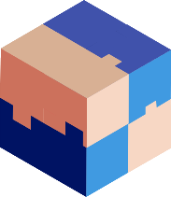


Container Scenarios in Service Fabric
Guest Containers
SF Services inside a container
Take advantage of Service Fabric’s cluster management and orchestration capabilities in the same way you would with guest executables
Reference a container image in Docker Hub, a Docker Trusted registry, or a private registry, and Service Fabric will pull down the and launch a container
Build Service Fabric stateless and stateful services using programming models optimized for productivity and then package them inside a container
Get all the benefits of native Service Fabric services, such as networking naming service support, self-reporting of load metrics and integration with code, config, & data upgrades, in addition to higher isolation levels provided by containers
Notes:
Service Fabric support for containers
Guest containers: This scenario is identical to the guest executable scenario where you can deploy existing applications in a container. Examples include Node.js, JavaScript, or any code (executables).
Stateless services inside containers: These are stateless services that use the Reliable Services and the Reliable Actors programming models. This is currently only supported on Linux. Support for stateless services in Windows containers will be added in future release.
Stateful services inside containers: These are stateful services that use the Reliable Actors programming model on Linux. Reliable Services are not currently supported on Linux. Support for stateful services in Windows containers will be added in future release.

Slide 28
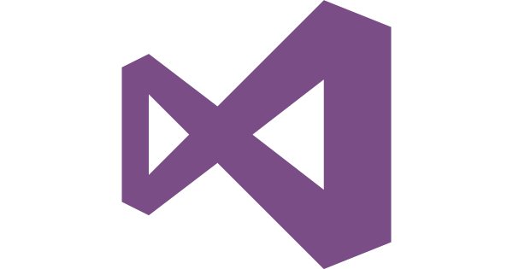
Container Developer Experience

Slide 29
Containers are central to DevOps process
Operations collaborates with developers to provide app metrics and insights.
Developers build, test and update apps in containers, using development environment; i.e., Visual Studio.
Physical/Virtual Servers
Operations automates deployment and monitors deployed apps from central repository.
Developers push containers to central repository.
Notes:
So what does a lifecycle look like?
Firstly, developers build and test their applications, in containers, on their own box. This could be using a development environment like Visual Studio, or one from a 3rd party. You’ll see in this case, there is a couple of different containers, perhaps representing 2 tiers of an application or workload.
Once completed, these containers are pushed to central repository. This could be a Docker repository, which you’ll learn more about later.
Operations automates deployment of the containers, from this central repository, to the target machines, which could be physical or virtual. They continue to monitor the containers…
…and collaborate with developers to provide them with insight and monitoring metrics which help the development teams gain insight into the usage of the applications.
This could be used to drive an update to a particular container, which, with the developers perform on their own boxes, iterate a version, and deploy the updated version to the central repository, which in turn, is then used to update the existing deployed containers. They could also, if they wanted, to roll it back to a previous version. Containers provides considerable flexibility in this space.

Slide 30
CI/CD to Service Fabric and ACS with Visual Studio Team Services
Continuous pipeline to Azure with Visual Studio Team Services
Use Azure Container Registry to store images
Easily promote images across environments
Notes:
Create a continuous pipeline to Azure Container Service with Visual Studio Team Services
You can write your app using the language of your choice (Java, C#, PHP, etc) and your favorite IDE (Eclipse, Visual Studio, IntelliJ, etc), with standard Docker assets. Then, using the Azure Command Line Interface (CLI), you can run a simple command to connect your source repository to a target Azure Container Service (ACS) cluster and set up a containerized build and deployment pipeline for a multi-container Docker application. So now anytime source code is pushed to a repository in GitHub, it can automatically trigger VSTS to build and tag container images, run unit tests, push to the Azure Container Registry, and deploy to ACS with zero-downtime. For Preview, we support creating pipelines that deploy to DC/OS only.
Use the Azure Container Registry to store images
Azure Container Registry is a private registry for hosting container images. Using the Azure Container Registry, customers can store Docker-formatted images for all types of container deployments. Azure Container Registry integrates well with orchestrators hosted in Azure Container Service, including Docker Swarm, DC/OS and Kubernetes. The continuous integration and deployment tools will push the container images to the Azure Container Registry after a build. Later, it will pull images from the container registry and deploy them into the ACS cluster.
Easily promote images across environments
The continuous integration and deployment tools support the immutable services principle. Which means, you can easily promote images from development to downstream release environments such as Test and Production and importantly, you don’t have to rebuild the container image each time you promote the image.

Slide 31
Visual Studio Tools for Docker to build, debug, and deploy container apps
Access and use a variety of tools and extensions to more easily work on your applications in a locally hosted or Azure-hosted Docker container.
Integrated Docker tooling
Multi-container support
Easily deploy containers to Azure

Slide 32
References
Notes:
Optional:
Service Fabric—Microservice Based Apps
Azure Service Fabric is a platform that developers and ISVs can use to build and manage custom microservice-based applications at cloud scale and with 24x7 availability. Microservices are an architectural approach based on fine-grained, loosely coupled services that can enable advanced developer agility, cloud scale, self-healing resilience and always on availability. Service Fabric is the foundation for many Microsoft services such as Azure SQL Database, Azure Document DB, Cortana, Windows Intune, and Skype for Business. We’ve taken the exact same technology and made it available to you. And use Service Fabric wherever you want to run your microservice based apps—whether in Azure, in your own datacenter or in other clouds—giving you maximum flexibility.

Slide 33
So what should you do next?
Azure App Service
Azure Functions
Try: https://functions.azure.com/try
Azure Service Fabric
Try: http://aka.ms/tryservicefabric
Azure Container Service
Try: http://aka.ms/acs
Try: https://tryappservice.azure.com
Ignite Session: Master modern PaaS for the enterprise with Azure App Service [BRK3205]
Ignite Session: Build applications with SF [BRK1036]
Ignite Session: Go serverless for the enterprise with Azure Functions [BRK2250]
Ignite Session: Deep Dive into ACS [BRK4008]
Download “Understanding Azure - a guide for developers” http://aka.ms/adg
The Total Economic Impact of Microsoft Azure PaaS https://azure.microsoft.com/resources/total-economic-impact-of-microsoft-azure-paas/

Slide 34
ACS References
Landing Page
aka.ms/acs
Documentation
https://azure.microsoft.com/en-us/documentation/services/container-service/
ARM Templates for Creating Azure Container Service
DC/OS: https://github.com/Azure/azure-quickstart-templates/tree/master/101-acs-dcos
Swarm: https://github.com/Azure/azure-quickstart-templates/tree/master/101-acs-swarm
Kubernetes: https://github.com/Azure/azure-quickstart-templates/tree/master/101-acs-kubernetes
Azure Container Service 101
https://channel9.msdn.com/Shows/Azure-Friday/Azure-Container-Service-101?ocid=player
Building applications using Azure Containers Service
https://channel9.msdn.com/Events/Build/2016/B822?ocid=player
Deep dive into Azure Container Service
https://channel9.msdn.com/Events/Ignite/2016/BRK4008-TS

Slide 35
Thank you!
Notes:
Optional:
Service Fabric—Microservice Based Apps
Azure Service Fabric is a platform that developers and ISVs can use to build and manage custom microservice-based applications at cloud scale and with 24x7 availability. Microservices are an architectural approach based on fine-grained, loosely coupled services that can enable advanced developer agility, cloud scale, self-healing resilience and always on availability. Service Fabric is the foundation for many Microsoft services such as Azure SQL Database, Azure Document DB, Cortana, Windows Intune, and Skype for Business. We’ve taken the exact same technology and made it available to you. And use Service Fabric wherever you want to run your microservice based apps—whether in Azure, in your own datacenter or in other clouds—giving you maximum flexibility.

Slide 36
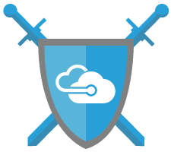
Windows Server Next steps
Learn more about Windows Server 2016: www.microsoft.com/WindowsServer2016
Review Windows containers documentation:
http://aka.ms/containers
Windows Server blog: http://blogs.technet.microsoft.com/windowsserver

Slide 37
Learn more about Containers on App Service
All our docs: https://aka.ms/webapp-linux
FAQ: https://aka.ms/linux-faq
Release notes: https://aka.ms/linux-release-notes

Slide 38
OMS
Github
https://github.com/Microsoft/OMS-Agent-for-Linux
Dockerhub – “microsoft/oms”
https://hub.docker.com/r/microsoft/oms/
Demo on OMS Experience Center
Go to https://oms-experience-center-2016.portal.mms.microsoft.com/
Blog
https://blogs.technet.microsoft.com/msoms/tag/keiko-harada/
OMS Documentation
https://docs.microsoft.com/en-us/azure/log-analytics/log-analytics-containers
Feedbacks
Email OMScontainers@microsoft.com

Slide 39
ACS References
Videos and Podcasts
Azure Friday: Azure Container Service 101
https://channel9.msdn.com/Shows/Azure-Friday/Azure-Container-Service-101
Azure Friday: Scaling Azure Container Service
https://channel9.msdn.com/Shows/Azure-Friday/Scaling-Azure-Container-Service
//Build 2016: Building Applications Using the Azure Container Service
https://channel9.msdn.com/Events/Build/2016/B822
Interview: Azure Container Service Strategy
http://www.microsoftcloudshow.com/podcast/Episodes/115-azure-container-service-acs-with-microsoft-s-ross-gardler?utm_content=buffereb3c1&utm_medium=social&utm_source=twitter.com&utm_campaign=buffer
Demo: Introduction to Docker and Azure Container Service
https://channel9.msdn.com/Shows/Cloud+Cover/Episode-198-Azure-Container-Service-with-Ross-Gardler
Demo: Getting started developing with Docker and Azure Container Service
https://channel9.msdn.com/Events/Visual-Studio/Connect-event-2015/915

Slide 40
Appendix
Notes:
Optional:
Service Fabric—Microservice Based Apps
Azure Service Fabric is a platform that developers and ISVs can use to build and manage custom microservice-based applications at cloud scale and with 24x7 availability. Microservices are an architectural approach based on fine-grained, loosely coupled services that can enable advanced developer agility, cloud scale, self-healing resilience and always on availability. Service Fabric is the foundation for many Microsoft services such as Azure SQL Database, Azure Document DB, Cortana, Windows Intune, and Skype for Business. We’ve taken the exact same technology and made it available to you. And use Service Fabric wherever you want to run your microservice based apps—whether in Azure, in your own datacenter or in other clouds—giving you maximum flexibility.

Slide 41
Positioning Containers on Azure
Notes:
Optional:

Slide 42
Ecosystem container solutions
Linux Containers
Azure Container Service
Enterprise Container Management platforms
Implication: Build your own container orchestration platform using Docker and other tools
Benefits: Customizable, pick best-of-breed solutions
Implication: Open Source Containers
Benefits: Quick ramp up, optimze choice of orchestrator
Implication: Enterprise grade container platforms from Docker, Mesosphere and Red Hat
Benefits: Ref next slide for trading up from OSS to ESS offerings
Linux Containers
Docker
Open source DC/OS
Kubernetes
Enterprise DC/OS
OpenShift
Docker CE
Docker Datacenter

Slide 43
Trade up from OSS to ESS container offerings through Azure Marketplace
Security, Advanced Operations, Multi tenancy, Advanced Networking & Storage, Support
Open source DC/OS
Enterprise DC/OS
Enhanced Security & Storage, Multi-tenancy, Self Service, DevOps, automation
Kubernetes
OpenShift
Universal Control Pane, Docker Trusted Registry , Docker Enterprise Edition
Docker Community Edition
Docker Datacenter

Slide 44
Microsoft container solutions
Windows Server Containers
Azure App Service
Service Fabric
Implication: Windows Server 2016 Containers, powered by Docker Engine
Benefits: Agility, portability, and security benefits of the Docker platform to Windows Server 2016
Implication: The easiest and fastest way to run single container web apps
Benefits: The platform will manage scaling, request routing and availability.
Implication: Azure Service Fabric is an orchestrator of services across a cluster of machines
Benefits: Use containers to package existing code or use Service Fabric programming models

Slide 45
Eagle’s view: Microsoft Container Technologies
Windows Server Containers
Service Fabric
App Service
Container Services
Docker Windows Server 2016
Microservices platform with
Windows and Linux Containers
Single Container Apps
Open Source
Hybrid Solution
Cloud Solution
Hybrid Solution

Slide 46
Microsoft offers maximum choice for Container App Lifecycle Management
 | Inner Loop | Outer Loop
Microsoft Technologies | Build->Push VS, VS Code, .Net | Deploy->Manage App Service, SF, ACS, DDC, OMS
OSS technologies | Build->Push Eclipse, Maven, Git, Jenkins | Deploy->Manage App Service, ACS, DDC, OMS

Slide 47

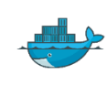





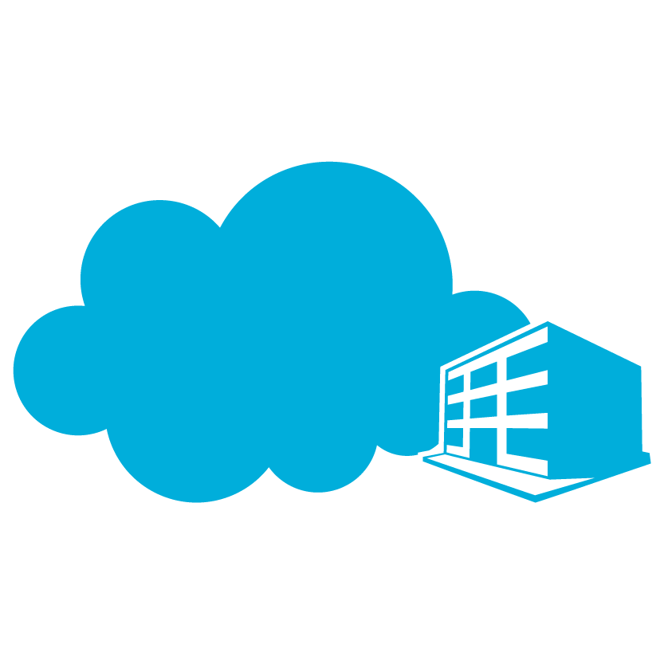

The right developer tools for you
Container management
PowerShell
Docker
Others
Development environments
Container technologies
Linux
Microsoft cloud
Others…
Azure
On premises
Service Provider
Notes:
Our goal as we bring containers to Windows Server was to offer multiple choices and tools. That means you can manage with PowerShell or with Docker. You will be able to choose in Azure between Linux containers and Windows Server Containers. And you can choose to run containers in Azure, in an on-premises datacenter or in a service provider datacenter. You can also take advantage of familiar tools to build applications.

Slide 48
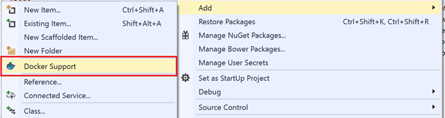
Docker Tools for Visual Studio 2015 (Preview)
https://aka.ms/DockerToolsForVS
Adds Dockerfile & scripts to project
Deploy & debug in containers

Slide 49
Windows Server Containers
Notes:
Optional:

Slide 50
Windows Server containers Anatomy and key capabilities
Build: Developers will use familiar development tools, such as Visual Studio, to write apps to run within containers.
By building modular apps leveraging containers, modules can scale independently, and be updated on independent cadences.
Run: Container capabilities built into Windows Server.
Manage: Deploy and manage containers using PowerShell, or using Docker.
Resources: Define CPU and memory resources per container along with storage and network throughput.
Network: Provide NAT or DHCP/static IP for network connectivity.
Container A
Container B
Container C
Web tier
App tier
DB tier
LOB app (+Binaries)
LOB app (+Binaries)
LOB app (+Binaries)
Libraries (Shared across containers)
Libraries
Host OS with container support
Server (Physical or Virtual)
Notes:
So what are some of the core Windows Server container capabilities.
The first key takeaway, is that there is core functionality for containers, supported natively within the kernel, and they will be available in the next release of Windows Server.
Developers will use familiar development tools, such as Visual Studio, to write apps to run within containers. Instead of trying to backport existing applications, by building modular apps leveraging containers, modules can scale independently, and be updated on independent cadences, providing the developer with much greater flexibility and speed.
Applications can rely on other packages to provide core functionality. As you can see from the graphic, there are 2 containers that are sharing a number of libraries. In addition, when packaging, the packages also depend on a base package which describes the underlying operating system, such as Server Core, which has a large number of APIs that Windows supports, such as .NET, IIS etc. Nano Server is another, however this has a much smaller surface, that will target apps that have been written from the ground up, with the cloud in mind.
Containers are isolated behind their own network compartment. This can be provided a NAT DHCP or Static IP. Each container has an independent session namespace, which helps to provide isolation and additional security. The kernel object namespace is isolated per container.
Each container also has access to certain CPU and memory resources, along with storage and network capacity – these are controlled by the administrator, and ensures predictable and guaranteed control of processes.
These containers can be managed using tools such as PowerShell, or using the Docker management tools.

Slide 51
Hyper-V containers Anatomy and key capabilities
Consistency: Hyper-V containers use the same APIs as Windows Server containers ensuring consistency across management and deployment toolsets.
Compatibility: Hyper-V containers use the exact same images as Windows Server containers.
Strong isolation: Each Hyper-V container has its own dedicated copy of the kernel.
Highly trusted: Built with proven Hyper-V virtualization technology.
Optimized: The virtualization layer and the operating system have been specifically optimized for containers
Hyper-V container
Hyper-V container
App A Bins/Libraries
App B Bins/Libraries
Windows Guest OS Optimized for Hyper-V container
Windows Guest OS Optimized for Hyper-V container
Hypervisor
Server
Notes:
Hyper-V containers take a slightly different approach to containerization. To create more isolation, Hyper-V containers each have their own copy of the Windows kernel and have memory assigned directly to them, a key requirement of strong isolation. We use Hyper-V for CPU, memory and IO isolation (like network and storage), delivering the same level of isolation found in VMs. Like for VMs, the host only exposes a small, constrained interface to the container for communication and sharing of host resources. This very limited sharing means Hyper-V containers have a bit less efficiency in startup times and density than Windows Server containers, but the isolation required to allow untrusted and “hostile multi-tenant” applications to run on the same host.
So aren’t Hyper-V containers the same as VMs? Besides the optimizations to the OS that result from it being fully aware that it’s in a container and not a physical machine, Hyper-V containers will be deployed using the magic of Docker and can use the exact same packages that run in Windows Server containers. Thus, the tradeoff of level of isolation versus efficiency/agility is a deploy-time decision, not a development-time decision – one made by the owner of the host.

Slide 52

Container operating system environments
Nano Server
Server Core
Highly optimized
Born-in-the-cloud applications
Highly compatible
Traditional applications
Notes:
Windows Server and Hyper-V Containers will both take advantage of the smaller installation options for Windows Server: Server Core and (new in Windows Server 2016) Nano Server. Nano Server is a highly-optimized, headless deployment option for Windows Server that runs at a fraction of the Windows Server footprint and is ideal for cloud services. Containers running Server Core are available now with Windows Server 2016 Technical Preview 3.

Slide 53
Windows Server Containers Reference Customer
“
By containerizing legacy applications using Windows Server containers, we gain better consistency and control between developers, testers, and deployment teams—a full DevOps environment—without changing the application.
“
Matthew Roberts Principle Software Engineer
Tyco International

Slide 54
Container technology comparison Comparing containers and virtual machines
 | Windows Server containers | Linux containers | Virtual machines
Base image | Same as host | Same as host | Any Windows/Linux
Multi-tenant security | Yes | No | Yes
Resource managed | Yes | Yes | Yes
Density | High | Higher | Lower
Startup time | Short | Shorter | Longer
Disk footprint | Small | Smaller | Larger
Operating System: Containers share same OS as host system, but can run inside virtual machines to enable OS flexibility.
Security: Virtual machines offer a higher level of protection against threats such as kernel exploits.
VM features: Whilst containers have faster startup time, virtual machines benefit from features such as live migration.
Density: The Windows server Docker images are large (9 GiB), so your container instances require more storage space than Linux container instances, which typically have smaller image sizes.
Notes:
How do the different containers and VM technologies compare?
As mentioned earlier, containers, regardless of Windows or Linux, need to share the same OS as the host they are running on, which is very different from a virtual machine, which can contain a variety of different operating systems, that don’t need to match the host itself. VMs however, do guarantee a higher level of security than containers, providing a level of hardware isolation that cannot be matched by containers today.
All 3 offerings allow resources, such as CPU, memory, disk and network, to be controlled and managed, ensuring that the administrators can deliver expected levels of performance and reliability.
When thinking about density, and the number of applications that can run on a particular server, the lighter weight nature of containers naturally leads to higher levels of density compared to virtual machines, which themselves, provide a much greater level of density versus running a 1:1 app to server consolidation in the physical world. In addition, the lightweight nature leads to reduced startup times for applications, versus starting up a virtual machine from cold, meaning IT can respond even quicker to changing business needs. VM’s however, do benefit from VM-specific features, such as live migration and high availability, both of which would not apply to containers themselves.
Having multiple VMs providing multiple apps, also consumes considerably more storage space. Each VM typically, in a production environment, has it’s own non-shared virtual hard disk, which, if for example, we assume the size of the virtual disk is 20GB, having 20 VMs each with an application inside, would consume well over 400GB. Compare this with containers, which would consume 20GB for the host OS, and only incremental add-ons for the application binaries themselves, on a per application basis, and it’s clear that the savings on storage are considerable.
Finally, from an application perspective, virtual machines, typically have a very high compatibility for running applications that were designed for physical systems. In many cases, most applications that are being developed today, are being developed and tested in virtual environments, however these apps, in their native form, are unlikely to work in containers without significant redevelopment work. To realize the greatest benefit, apps should be designed, architected and written for containers i.e. stateless, componentized versus ports of traditional, monolithic apps.
Density
The Windows server Docker images are large (9 GiB), so your container instances require more storage space than Linux container instances, which typically have smaller image sizes.
Container instances can take up to 15 minutes to download and extract the Windows server Docker images the first time they use them. This time can be doubled if you enable IAM roles for tasks.

Slide 55
Any cloud
Operations
Management
Suite
Container Solution
Any platform
Notes:
Optional:

Slide 56

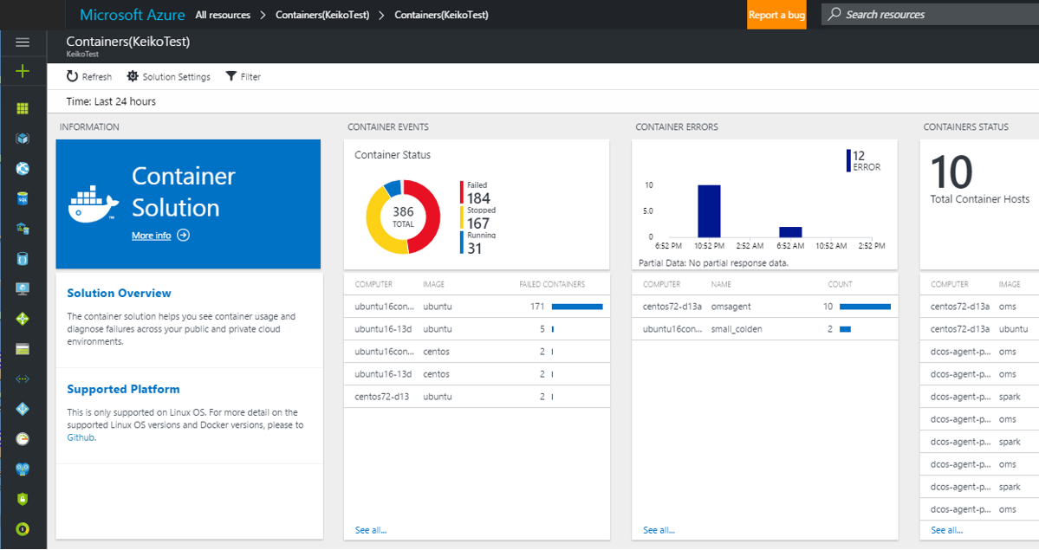
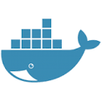
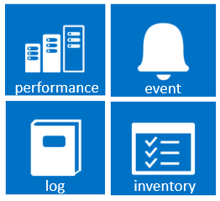
UNIFIED EXPERIENCE
COLLECT AND INDEX DATA
SEARCH AND INVESTIGATE
CORRELATE AND ANALYZE
VISUALIZE AND REPORT
MONITOR AND ALERT
Gain immediate insight from containers
Containers are lightweight, pared-down virtual machines that can be easily provisioned, developers have created them sporadically as a solution to support their continuous delivery. As containers are being used widely in production and are exploding in numbers, demand for container monitoring has increased. A centralized approach to logging and monitoring is required. OMS Container Solution helps with these needs.
https://blogs.technet.microsoft.com/msoms/2016/08/24/announcing-public-preview-oms-container-solution-for-linux/

Slide 57


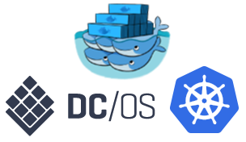
How to Deploy OMS?
Docker hub
microsoft/oms
OMS Agent for Linux
deploy
onboard
Azure OMS - Container Solution
Docker Orchestration

Slide 58

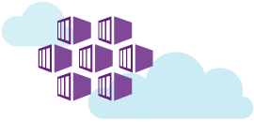
Operations Management Suite Container Solution
Support Docker Swarm, DCOS, Kubernetes
Standardize monitoring regardless of the Docker orchestration and platform
Linux and Windows Server Container
Azure, on premise, and other cloud environment
Azure Container Service

